Slide 1
CSR Connectivity Check
Jayeshkumar Patel

Slide 2
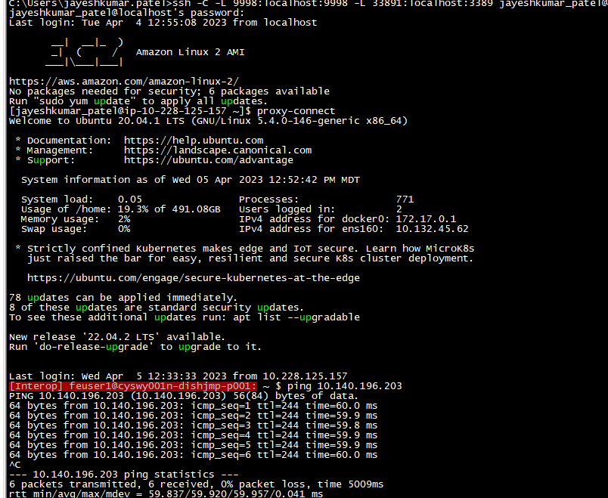
Steps to Run the Script
Create CSV input files same as below
Login to ops jump server
SiteID | CSR IP Info
CLRDU00225A | 10.140.196.203

Slide 3
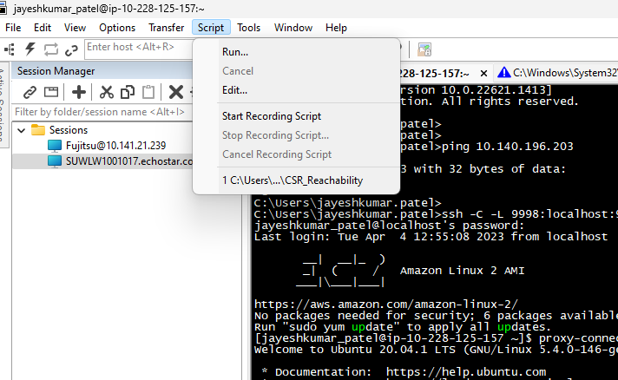
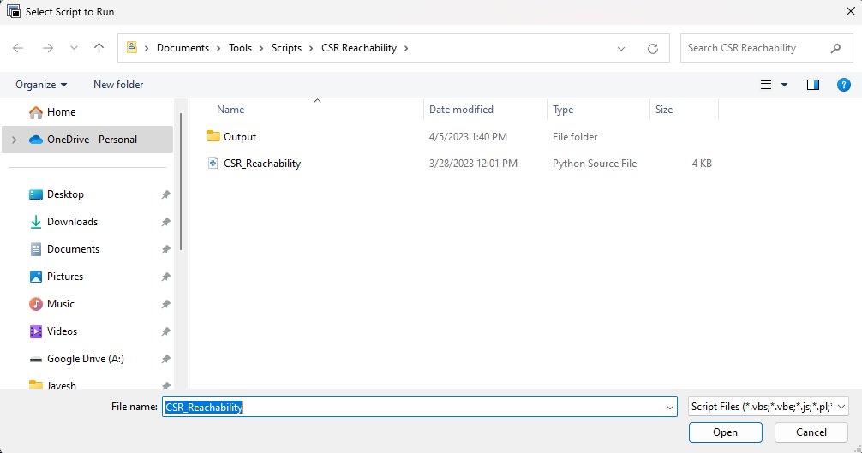
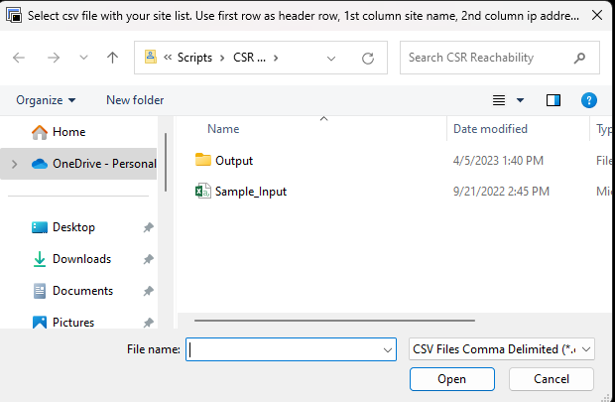
Steps to Run the Script
3. Click on Script tab and Run
4. Select Script and CSV file which you created with Site ID and IP address

Slide 4
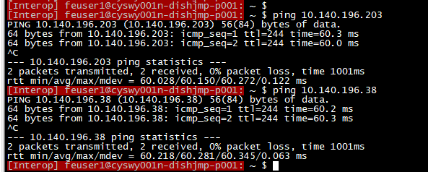
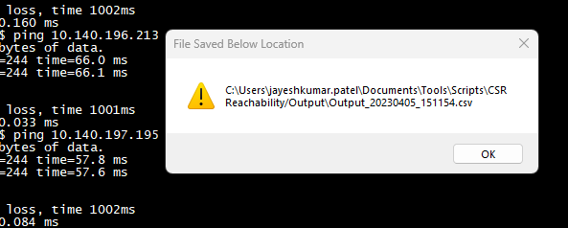
Steps to Run the Script
5. Once script start run you will see progress on screen and once complete message will pop up with location of output file.
6. Once script Complete output file will open with below info if CSR Reachable then you will “YES” otherwise “NO”
Site ID | Reachability Status
CLRDU00225A | YES

